Slide 1
In-Kernel fast path performance for containers running Telecom Workloads
Nishanth Shyamkumar, Piotr Raczynski, Dave Cremins, Michal Kubiak, Ashok Sunder Rajan - [ Intel Corporation ]

Slide 2
Telco VNFs
vCGNAT
vUPF
vFirewall
CGNAT
UPF
Proprietary OS + Software
Proprietary OS + Software
Open-Source Software
Special purpose hardware
Special purpose hardware
Commodity Hardware
Virtualization of Telecom Network Function, to move away from fixed function paradigm.
Shift from VMs to containers as unit of deployment. Lightweight and quickly deployable.
Gaps:
Fast path performance
Scalability
Minimize system integration overhead

Slide 3
Container Networking
Root/Default
Containers use:
ns1
ns2
Namespaces(isolation) and cgroups(Resource control)
Kernel sandboxes a group of processes through PID, mount and network namespaces
NW
Stack
NW
Stack
Root is default host namespace, ns1 & ns2 are container namespaces.
Each container gets its’ own route/arp table, ephemeral ports and netfilter rules.
Interfaces are unique to a network namespace
NW Stack
Network Interface card

Slide 4
Why containers can create processing overhead ?
L2 Bridge
MACVLAN
Root
Root
ns1
ns2
ns1
ns2
macvlan
macvlan
veth
veth
v
v
v
v
L2 Bridge
Macvlan Group
Phy if
Phy if
v
v
Traverses root namespace network stack
Netfilter rules to route packet to bridge
Bridge selects the right interface
Traverses ns1/ns2 network stack
CPU cycles spent in Kernel space and for copy operations
Traverses root namespace network stack
Macvlan Table lookup
Table selects the right interface
Traverses ns1/ns2 network stack
CPU cycles spent in Kernel space and for copy operations

Slide 5
SRIOV VFs
Host
ns1
ns2
ns3
SRIOV is a HW Virtualization solution
VFs are light-weight PCIe functions
VFs are assigned a pool of Queue pairs
VFs provide scalability
Queue select filtering routes packet to specific queue pair(RSS, Flow Director etc.)
VF interface
VF interface
VF interface
QP
QP
QP
VF0
VF1
VF2

Slide 6
AF_XDP
Traditional NW path:
AF_XDP NW path:
AF_INET socket fd
AF_XDP socket fd
User
TCP/UDP
UMEM
frame
frame
Kernel
frame
IP + Netfilter
eBPF is a small program that runs at specific hook points in the kernel
AF_XDP socket binds to a specific Queue pair
No sk_buff creation
UMEM is allocated memory in user-space
Lockless rings to transfer frame control
Traffic class
xdp_frame
sk_buff
eBPF program
Driver
Driver

Slide 7
Zero copy in AF_XDP
8. Read frame data from UMEM(ZC)
AF_XDP socket fd
frame
frame
UMEM
frame
1. Update Fill ring with empty frame address
7. Read Rx Q
User
Fill
ring
Completion ring
Rx ring
Tx
ring
2. Program HW RX desc
Kernel
4. IRQ
6. Update Rx Q
3. DMA
DRIVER
5. eBPF
HW
QP
SRIOV VF

Slide 8
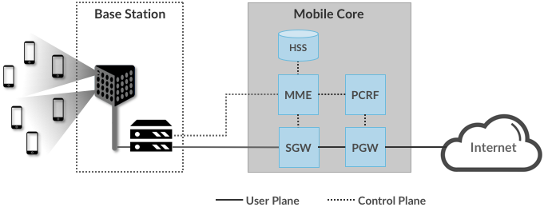
Telecom 4G Architecture
Workload for MEC:
1 MEC Site | 250K devices
Avg packet size | 500 Bytes
Aggregate load@250K devices | 10 Gbps
Aggregate load@250K devices | 2.5 MPPS
Image: https://5g.systemsapproach.org/arch.html#main-components
UEs(Mobile phones, Wireless devices) connect to a cell tower/Base station through radio signals
Wired infrastructure carries signals from Base Station to Mobile Core(GTP-C and GTP-U UDP packets)
HSS, MME, PCRF deal with management and User subscription information
SGW – PGW(aka UPF) provides data path to the Internet
Distributed Packet core at MEC site(https://opennetworking.org/news-and-events/press-releases/t-mobile-poland-achieves-production-roll-out-of-omec-onfs-open-source-mobile-evolved-packet-core/)

Slide 9
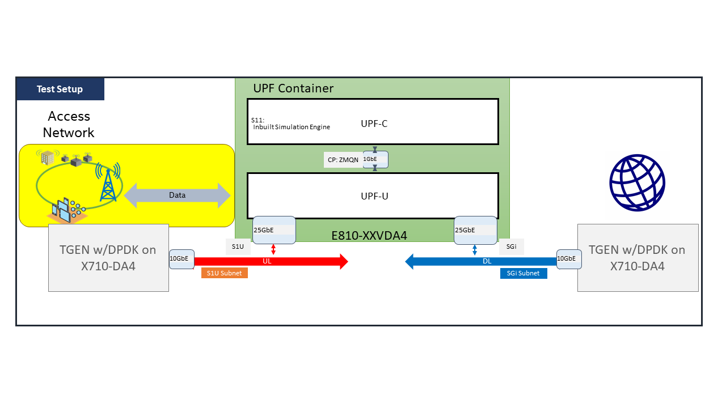

Experimental Test Setup
Intel(R) Xeon(R) Platinum 8260 CPU @ 2.40GHz(Skylake)
Kernel: Linux 5.15.0-23-generic
Test Duration |  | 50
PKT_SZ(bytes) |  | 512
num_enb |  | 20
Flows |  | 8,000
pps |  | 2,400,000
NW Virtualization modes:
L2, MACVLAN, IPVLAN, SRIOV
TGEN used is a software based Pktgen running on DPDK.
TGEN simulates UE, enodeB and provides GTP support
Docker is used to enable the UPF container.
Container Networks for L2 Bridge, MACVLAN, IPVLAN created using Docker commands.
Pipework used to move VF interfaces into Container namespace.

Slide 10
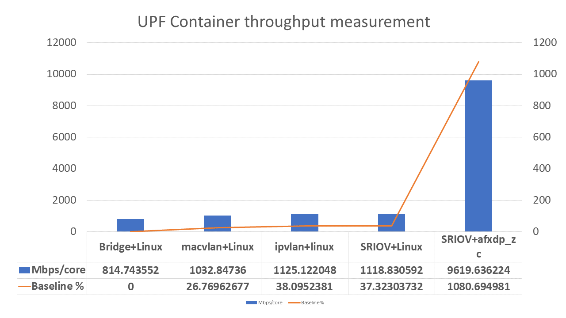
Performance Results / Takeaways
Results depicted as ‘Bridging method + NW processing datapath’
L2 bridge least performant due to Netfilter rule matching including NAT translations.
SRIOV + Linux limited due to packet copy(kernel/userspace) and Linux Network stack processing.
SRIOV + afxdp_zc doesn’t need 10 cores to achieve 2MPPS throughput.

Slide 11
Conclusion:
SRIOV + afxdp_zc provides ~10x performance as compared to other In-kernel mechanisms, lowering TCO.
Kernel space handles Network hardware queue programming and operation, improving system security.
ARP resolution, ifconfig/ip & ethtool statistics availability.
HW IO Virtualization removes bridging overhead, and provides scalability .
Future work:
Integrate into Kubernetes Orchestration framework.
Test scalability and learn about performance thresholds.
Reduce Permissions/privileges to deploy in a pod.
Upstreaming iavf driver modifications.

Slide 12
References:
Intel 82599 10 GbE Controller Datasheet
AF PACKET V4 and PACKET ZEROCOPY - Magnus Karlsson, Bjorn Topel, and John Fastabend
The Path to DPDK Speeds for AF XDP - Magnus Karlsson and Bjorn Topel
Understanding Linux Network Internals – Christian Benvenuti
Linux Containers and Virtualization – Shashank Mohan Jain
ebpf documentation. ebpf.io/what-is-ebpf
5G Mobile Networks: A Systems Approach, Larry Peterson and Oguz Sunay, https://github.com/SystemsApproach/5G, CC BY-NC-ND 4.0
Petazzoni, J. Pipework software-defined networking for
linux containers. https://github.com/jpetazzo/pipework
3GPP. Ts 29.274 technical specification

Slide 13
References contd.
Høiland-Jørgensen, T.; Brouer, J. D.; Borkmann, D.;
Fastabend, J.; Herbert, T.; Ahern, D.; and Miller, D. 2018.
The express data path: Fast programmable packet processing in the operating system kernel. CoNEXT ’18 54–66
Kumar, D.; Chakrabarti, S.; Rajan, A. S.; and Huang, J.
2020. Scaling telecom core network functions in public
cloud infrastructure. CloudCom
Rajan, A. S.; Gobriel, S.; Maciocco, C.; Ramia, K. B.;
Kapur, S.; Singh, A.; Erman, J.; Gopalakrishnan, V.; and
Jana, R. 2015. Understanding the bottlenecks in virtualizing cellular core network functions. The 21st IEEE
International Workshop on Local and Metropolitan Area
Networks

Slide 14
Notices & Disclaimers:
Performance varies by use, configuration and other factors.
Your costs and results may vary.
Intel technologies may require enabled hardware, software or service activation.
© Intel Corporation. Intel, the Intel logo, and other Intel marks are trademarks of Intel Corporation or its subsidiaries. Other names and brands may be claimed as the property of others.

